Slide 1



Country Population For 2020
View in Power BI
Last data refresh:
8/2/2021 2:34:16 PM UTC
Downloaded at:
8/2/2021 8:15:17 PM UTC

Slide 2
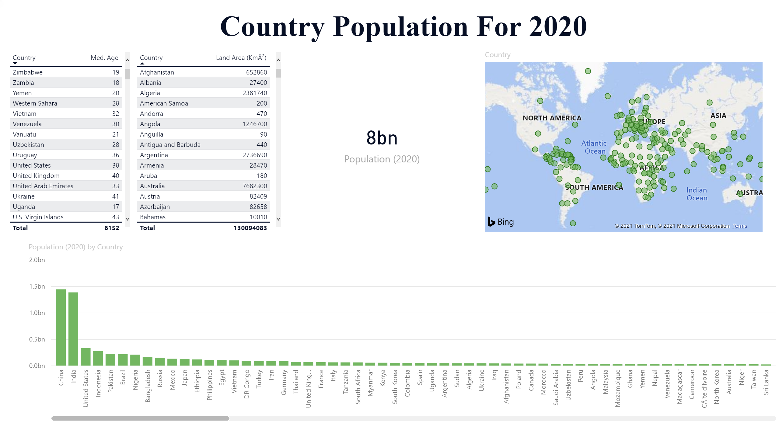
Page 1
Notes:
clusteredColumnChart
No alt text provided.
tableEx
No alt text provided.
tableEx
No alt text provided.
card
No alt text provided.
map
No alt text provided.
textbox
No alt text provided.

